Slide 1
The Past, Present, and Future of Mobile Technologies
- Jacob Storer

Slide 2
Introduction
This presentation will include a brief look into the past, present, and future of mobile technologies. This includes a look into the history of:
The Android Operating System.
The iOS Operating System and mobile Apple devices.
The Windows Mobile group of operating systems and mobile Windows devices.
The BlackBerry Operating system.
In terms of the present state of mobile technologies, the current market share and distribution of the four aforementioned operating systems will also be described.
Finally, for the future of mobile technologies, this presentation will include a brief look into ‘Wearable’ devices, such as the Apple Watch and Android Wear.

Slide 3
The Past
The Android Operating System
Development of the Android operating system began in 2005, and was unveiled in 2007.
The Android mobile operating system was eventually released in 2008, and was designed primarily for the use of touchscreen mobile devices, such as smartphones and tablets. The Android operating system also went on to provide specialized user interfaces for televisions, watches and cars.
In the first five years of the release of Android, the Google Play store had recorded over one million published Android applications, with over 50 billion applications downloaded. Since then, the Android operating system has the largest installed base of all general-purpose operating systems.
Since its release, key versions of the Android operating systems have been named under a confectionery-themed naming convention. The names used so far, and their corresponding version numbers, are as follows:
Cupcake (Version 1.5)
Donut (Version 1.6)
Éclair (Versions 2.0-2.1)
Froyo (Versions 2.2-2.2.3)
Gingerbread (Versions 2.3-2.3.7)
Honeycomb (Versions 3.0-3.2.6)
Ice Cream Sandwich (Versions 4.0-4.0.4)
Jelly Bean (Versions 4.1-4.3.1)
KitKat (Versions 4.4-4.4.4)
Lollipop (Versions 5.0-5.1.1)

Slide 4
The Past
The iOS Operating System
The iOS, originally the iPhone OS, mobile operating system was created and developed by Apple Inc.. The development of the iOS began in 2004, upon the conception of the iPhone.
The iPhone and its operating system were unveiled in 2007, though the iOS has extended to support other Apple devices, such as the iPod Touch, in late 2006, the iPad, in early 2010, the iPad Mini, in late 2012, and the Apple TV.
Since the release of the first iPhone, in late 2007, there have been eight generations of iPhone models, all of which have been supported by the iOS operating system.

Slide 5
The Past
Windows
In October 2010, Microsoft released the competitive Windows Phone into the market of smartphones and other mobile devices. ‘Windows Phone’ refers to the family of mobile operating systems which support Microsoft’s mobile devices.
Windows Phone was developed as the replacement successor to Windows Mobile and Zune. Unlike the Windows Mobile system, Windows Phone operating systems were designed primarily with the consumer market in mind, as opposed to the enterprise software market.
The origin of the Windows Mobile family of operating systems dates back to Windows CE, an operating system for embedded Windows systems, in 1996, though what is now described as ‘Windows Mobile’ first appeared in the year 2000, and was originally known as ‘PocketPC’.
In 2007, Windows Mobile was the most popular smartphone operating system, until competition arose from the iOS and Android systems.

Slide 6
The Past
BlackBerry
BlackBerry 10, the most recently released of BlackBerry Limited’s mobile operating systems, was released in the first quarter of 2013, and was built completely from the ground up.
While the BlackBerry 10 OS supports a wide range of hand-held devices, it is also popularly used as an interface for industrial computers and many car computers.
The BlackBerry 10, when it was released, was the third major release of BlackBerry’s QNX, a Unix-like operating system acquired by BlackBerry in 2010, based mobile operating system. Before it, BlackBerry had released two versions of the BlackBerry Tablet OS, which shares many similarities with their smartphone system.
In 2014, in a critical move for the success of the BlackBerry 10 system, BlackBerry Limited released update 10.2, which provided access to the downloading of Android applications, and was further integrated with the Amazon Appstore, in the 10.3 update.

Slide 7
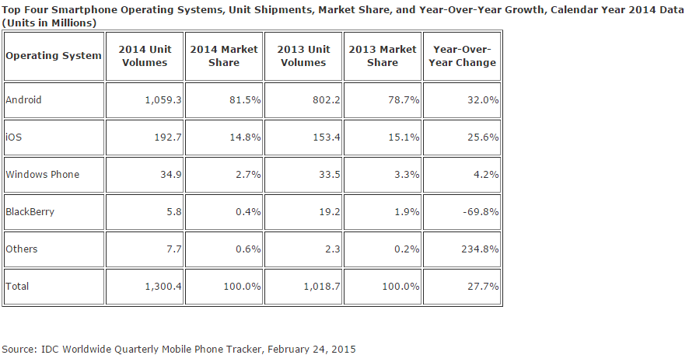
The Present
Market Share of Operating Systems
Source: http://www.idc.com/getdoc.jsp?containerId=prUS25450615

Slide 8
The Present
Distribution of Android
The list below shows the distribution of devices that are presently running different versions of Android, in terms of the percentage of total Android devices, over a 7-day recording period, which deliberately excludes versions of Android prior to 2.2 and any versions with less than a 0.1% distribution:
Froyo – 0.3%
Gingerbread – 5.7%
Ice Cream Sandwich – 5.3%
Jelly Bean – 15.6% (4.1.x) + 18.1% (4.2.x) + 5.5% (4.3)
KitKat – 39.8%
Lollipop – 9.0% (5.0) + 0.7% (5.1)
Source: https://developer.android.com/about/dashboards/index.html?utm_source=suzunone

Slide 9
The Present
Adoption of iOS
This section describes the adoption rate of new versions of iOS, as in how many users use each version of the iOS operating system.
As of May 12 2015, 73.8% of users have upgraded to version 8.X of iOS, 20% use 7.X, 3.8% use 6.X, and 2.1% of users still use the 5.X platform. These statistics can be divided into the two main devices that are supported by the iOS operating system.
For iPhone devices, the statistics are as follows:
8.X – 75.5%
7.X – 21.8%
6.X – 2.1%
5.X – 0.5%
For iPad devices, the statistics are as follows:
8.X – 75.0%
7.X – 17.6%
6.X – 1.3%
5.X – 5.4%
Source: http://david-smith.org/iosversionstats/

Slide 10
The Future
The ‘Internet of Things’
On March 25th 2015, Facebook introduced a series of new software development kits for its mobile application development platform, Parse. These new development kits will allow developers to incorporate data from Internet-connected devices into the platform, to allow for an easier time when weaving data from connected devices into their applications.
The concept of the ‘Internet of Things’ is the network of physical objects, or ‘things’, that are embedded with electronics or software, which would enable them to achieve a greater value or provide a greater service by exchanging data with their manufacturer.
A good example of this is the ‘Amazon Dash Button’, which can be attached to objects in the household of a consumer and pressed to immediately send a signal to the manufacturer of a particular product, to order a quick delivery of it. Presently, this is being used to replenish kitchen goods, though it could be implemented in other fields.

Slide 11
The Future
Wearables
‘Wearables’ have become a popular topic in recent years, particularly with the advent of the Apple Watch and the Android Wear, both of which are effectively ‘smartwatches’, which not only tell the time, but can also support Apps similar to those found in the iPhone, iPad or Android devices.
The strength in these devices are their portability and their security, as a device that is strapped around the wrist is less likely to be lost or stolen.
Presently, the Apple Watch is being marketed as being ‘personal’, with several key applications in terms of interaction with technology and fitness. The Android Wear also boasts about offering assistance in fitness routines by keeping track of the user’s step count and heart rate.
These ‘Wearables’ are also advertised as being fashion items, as opposed to just technical devices.

